Slide 1

DATA STRUCTURE WEEK 15
Contact Details:
Email: sobia.iftikhar@nu.edu.pk
GCR:

Slide 2
Content
Load Facctor
Rehashing
Graph

Slide 3
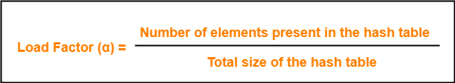
Load Factor
The load factor is a measure that decides when to increase the Hashtable
The default value of the load factor of HashMap is 0.75 (75% of the map size).
This Load Factor needs to be kept low, so that number of entries at one index is less and so is the complexity almost constant, i.e., O(1).

Slide 4
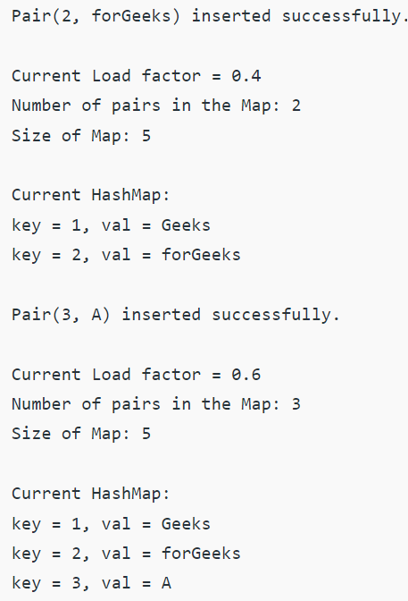
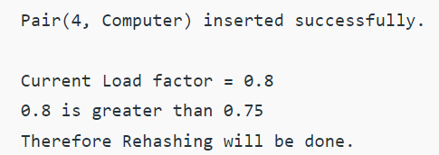
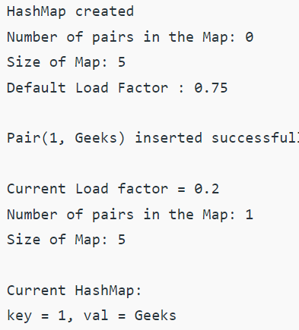
EXAMPLE

Slide 5
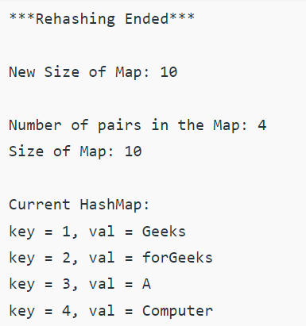
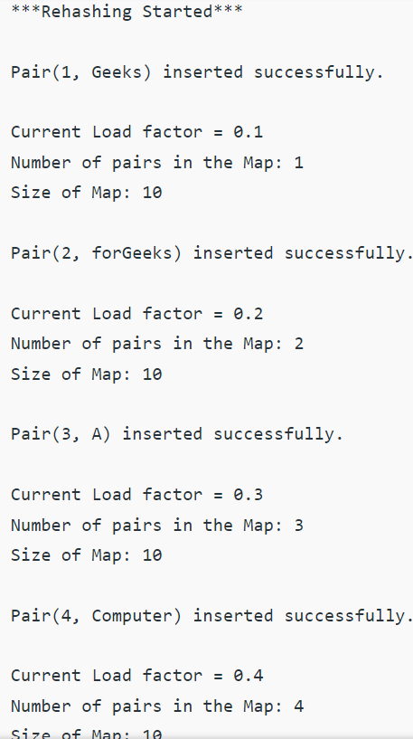
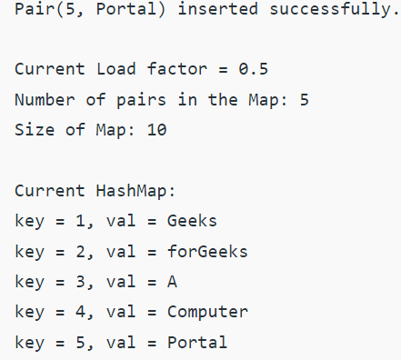

Slide 6
Definition of Graphs
Graphs in data structures are non-linear data structures made up of a finite number of nodes or vertices and the edges that connect them.
Graphs in data structures are used to address real-world problems in which it represents the problem area as:
a network like telephone networks, circuit networks, and social networks. For example, it can represent a single user as nodes or vertices in a telephone network, while the link between them via telephone represents edges.

Slide 7
Real Time Application of Graph
In Computer science graphs are used to represent the flow of computation.
Google maps uses graphs for building transportation systems, where intersection of two(or more) roads are considered to be a vertex and the road connecting two vertices is considered to be an edge, thus their navigation system is based on the algorithm to calculate the shortest path between two vertices.
In Facebook, users are considered to be the vertices and if they are friends then there is an edge running between them. Facebook’s Friend suggestion algorithm uses graph theory. Facebook is an example of undirected graph.
In World Wide Web, web pages are considered to be the vertices. There is an edge from a page u to other page v if there is a link of page v on page u. This is an example of Directed graph. It was the basic idea behind Google Page Ranking Algorithm.
In Operating System, we come across the Resource Allocation Graph where each process and resources are considered to be vertices. Edges are drawn from resources to the allocated process, or from requesting process to the requested resource. If this leads to any formation of a cycle then a deadlock will occur.
In mapping system we use graph. It is useful to find out which is an excellent place from the location as well as your nearby location. In GPS we also use graphs.
Facebook uses graphs. Using graphs suggests mutual friends. it shows a list of the f following pages, friends, and contact list.
Microsoft Excel uses DAG means Directed Acyclic Graphs.
In the Dijkstra algorithm, we use a graph. we find the smallest path between two or many nodes.

Slide 8
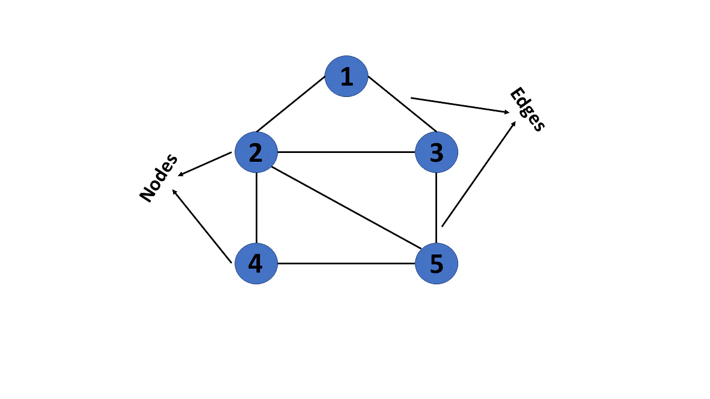
Graph Representation
This graph has a set of vertices V= { 1,2,3,4,5} and a set of edges E= { (1,2),(1,3),(2,3),(2,4),(2,5),(3,5),(4,50 }.

Slide 9
Examples of Graphs
V={0,1,2,3,4}
E={(0,1), (1,2), (0,3), (3,0), (2,2), (4,3)}
1
When (x,y) is an edge,
we say that x is adjacent to y, and y is adjacent from x.
0 is adjacent to 1.
1 is not adjacent to 0.
2 is adjacent from 1.
0
2
4
3

Slide 10
A “Real-life” Example of a Graph
V=set of 6 people: John, Mary, Joe, Helen, Tom, and Paul, of ages 12, 15, 12, 15, 13, and 13, respectively.
E ={(x,y) | if x is younger than y}
Mary
Helen
John
Joe
Tom
Paul

Slide 11
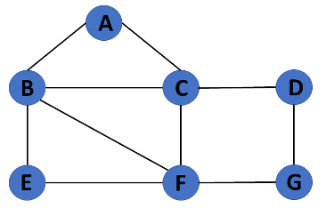
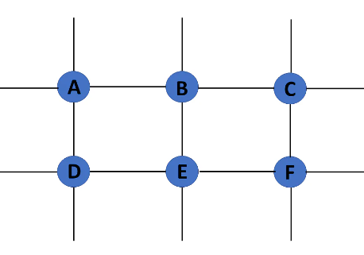
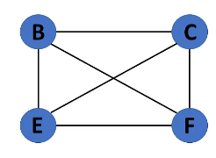

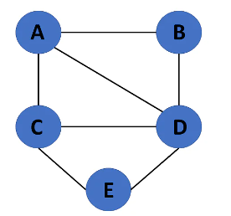
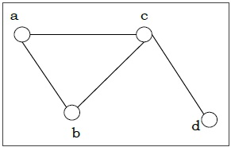
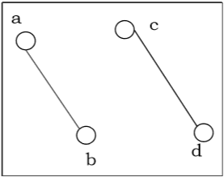
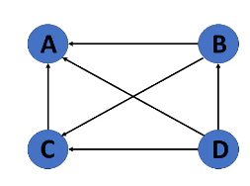
Types of Graphs in Data Structures
Finite Graph
In Finite Graph
Trivial Graph
Simple Graph
Direct Graph
In Direct Graph
Connected Graph
Dis Connected Graph

Slide 12
Graph Representation
For graphs to be computationally useful, they have to be conveniently represented in programs
There are two computer representations of graphs:
Adjacency matrix representation
Adjacency lists representation

Slide 13
Example of Adjacency Matrix
1
0
0 1 0 1 0
0 0 1 0 0
0 0 1 0 0
1 0 0 0 0
0 0 0 4 0
A =
2
4
3

Slide 14
Another Example of Adj. Matrix
Re-label the nodes with numerical labels
Mary 0
Helen 1
0 0 0 0 0 0
0 0 0 0 0 0
1 1 0 0 1 1
1 1 0 0 1 1
1 1 0 0 0 0
1 1 0 0 0 0
A =
Joe 3
John 2
Tom 4
Paul 5

Slide 15
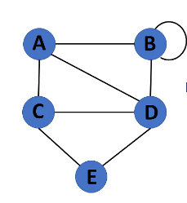
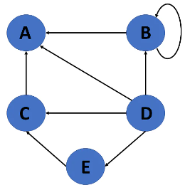
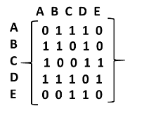
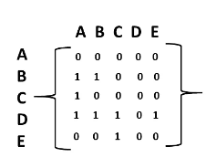
Example
Directed Graph Representation
Undirected Graph Representation

Slide 16
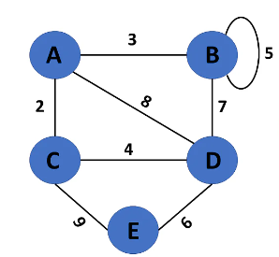
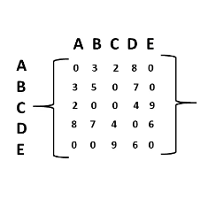
Example

Slide 17
Pros and Cons of Adjacency Matrices
Pros:
Simple to implement
Easy and fast to tell if a pair (i,j) is an edge: simply check if A[i][j] is 1 or 0
Cons:
No matter how few edges the graph has, the matrix takes O(n²) in memory

Slide 18
Adjacency Lists Representation
A graph of n nodes is represented by a one-dimensional array L of linked lists, where
L[i] is the linked list containing all the nodes adjacent from node i.
The nodes in the list L[i] are in no particular order

Slide 19
Example of Linked Representation
L[0]: empty
L[1]: empty
L[2]: 0, 1, 4, 5
L[3]: 0, 1, 4, 5
L[4]: 0, 1
L[5]: 0, 1
Mary 0
Helen 1
Joe 3
John 2
Tom 4
Paul 5

Slide 20
Pros and Cons of Adjacency Lists
Pros:
Saves on space (memory): the representation takes as many memory words as there are nodes and edge.
Cons:
It can take up to O(n) time to determine if a pair of nodes (i,j) is an edge: one would have to search the linked list L[i], which takes time proportional to the length of L[i].

Slide 21
Operations on Graphs in Data Structures
Creating graphs
Insert vertex
Delete vertex
Insert edge
Delete edge

Slide 22
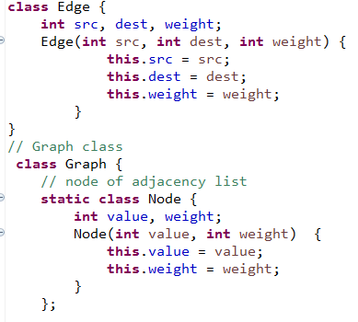
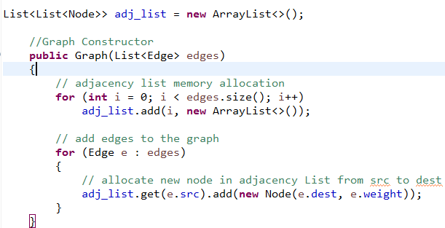
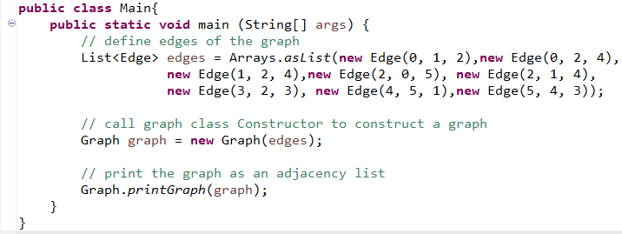
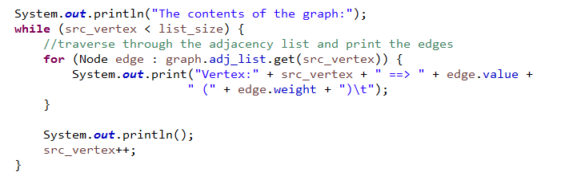
Implementation of Graph using List

Slide 23
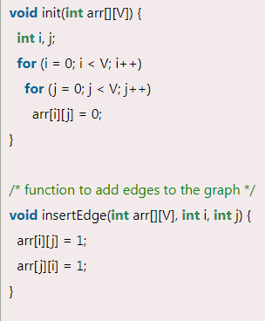
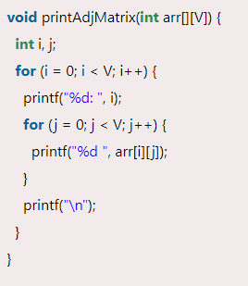
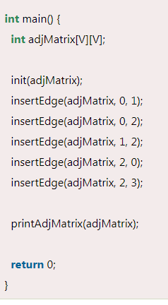
Implementation of Graph using Matrix

Slide 24
Graph Traversal Techniques
The previous connectivity problem, as well as many other graph problems, can be solved using graph traversal techniques
There are two standard graph traversal techniques:
Depth-First Search (DFS)
Breadth-First Search (BFS)

Slide 25
Graph Traversal (Contd.)
In both DFS and BFS, the nodes of the undirected graph are visited in a systematic manner so that every node is visited exactly one.
Both BFS and DFS give rise to a tree:
When a node x is visited, it is labeled as visited, and it is added to the tree
If the traversal got to node x from node y, y is viewed as the parent of x, and x a child of y

Slide 26
Depth-First Search
Algorithm
Step 1: Start with the root node and insert it into the stack
Step 2: Pop the item from the stack and insert into the ‘visited’ list
Step 3: For node marked as ‘visited’ (or in visited list), add the adjacent nodes of this node that are not yet marked visited, to the stack.
Step 4: Repeat steps 2 and 3 until the stack is empty.
Depth-first search (DFS) is a technique that is used to traverse a tree or a graph. DFS technique starts with a root node and then traverses the adjacent nodes of the root node by going deeper into the graph. In the DFS technique, the nodes are traversed depth-wise until there are no more children to explore.
Once we reach the leaf node (no more child nodes), the DFS backtracks and starts with other nodes and carries out traversal in a similar manner. DFS technique uses a stack data structure to store the nodes that are being traversed.

Slide 27
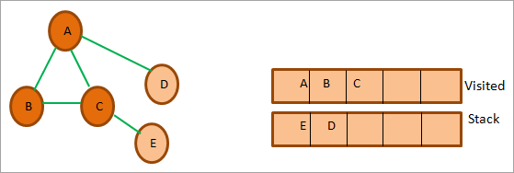
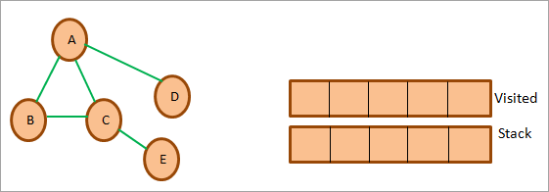
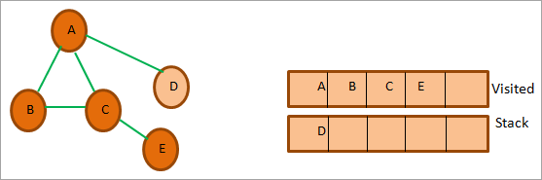
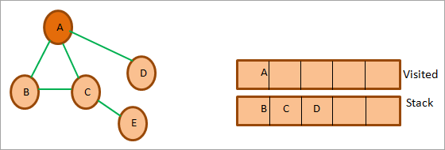
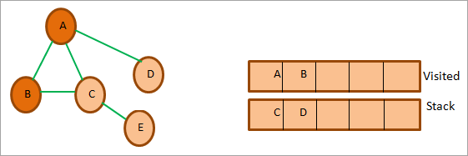
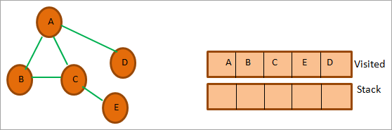
Example
The final DFS sequence for the above graph is A->B->C->E->D.

Slide 28
Illustration of DFS
0
1
0
2
1
4
4
9
10
5
7
2
11
8
5
9
6
7
11
6
Graph G
8
10
DFS Tree

Slide 29
DFS (Pseudo Code)
DFS(G,v) ( v is the vertex where the search starts )
Stack S := {}; ( start with an empty stack )
for each vertex u, set visited[u] := false;
push S, v;
while (S is not empty) do
u := pop S;
if (not visited[u]) then
visited[u] := true;
for each unvisited neighbour w of uu
push S, w;
end if
end while
END DFS()

Slide 30
Application of DFS
Detecting cycle in a graph
Path Finding
Finding Strongly Connected Components of a graph
We can specialize the DFS algorithm to find a path between two given vertices u and z.
Call DFS(G, u) with u as the start vertex.
Use a stack S to keep track of the path between the start vertex and the current vertex.
As soon as destination vertex z is encountered, return the path as the contents of the stack

Slide 31
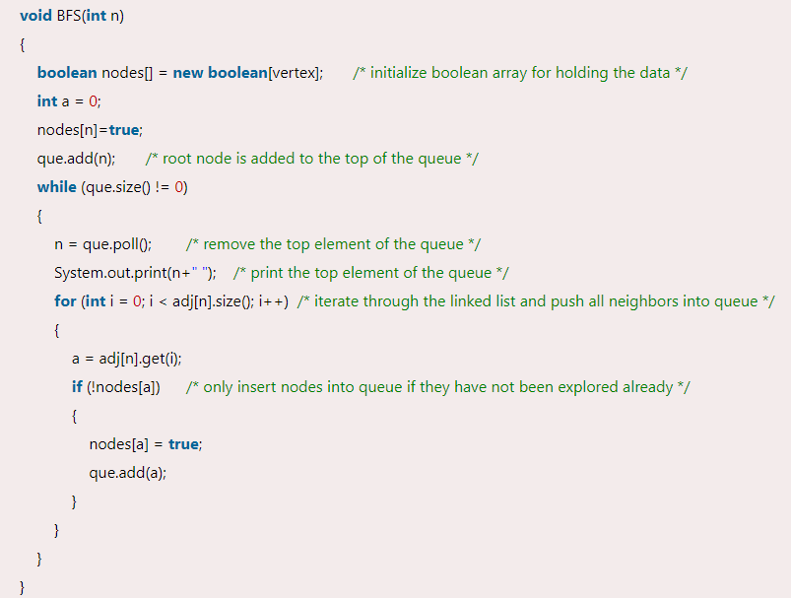
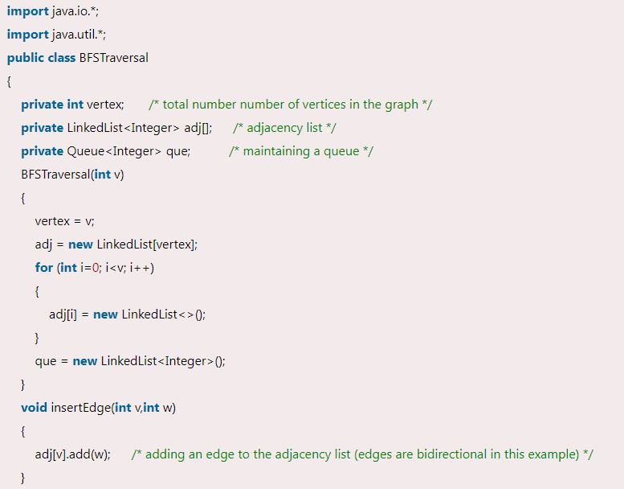
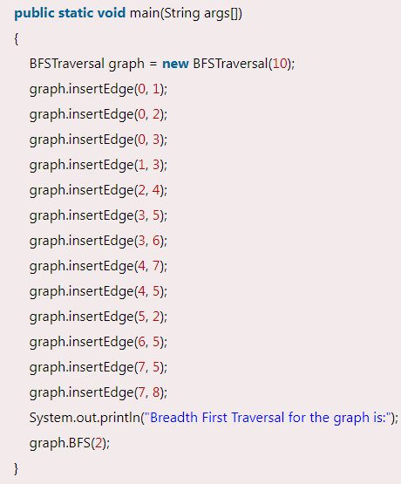
BFS

Slide 32
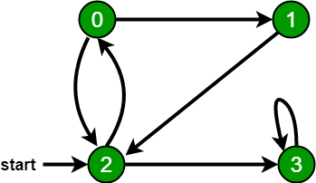
Breadth First Search or BFS for a Graph
There can be multiple BFS traversals for a graph. Different BFS traversals for the above graph :
2, 3, 0, 1
2, 0, 3, 1

Slide 33
Breadth-First Search
BFS follows the following rules:
Select an unvisited node x, visit it, have it be the root in a BFS tree being formed. Its level is called the current level.
From each node z in the current level, in the order in which the level nodes were visited, visit all the unvisited neighbors of z. The newly visited nodes from this level form a new level that becomes the next current level.
Repeat step 2 until no more nodes can be visited.
If there are still unvisited nodes, repeat from Step 1.

Slide 34
Illustration of BFS
0
1
0
2
4
2
1
4
9
5
9
10
10
5
7
11
8
6
7
8
11
6
BFS Tree
Graph G

Slide 35
Implementation Of BFS
Follow the below method to implement BFS traversal.
Declare a queue and insert the starting vertex.
Initialize a visited array and mark the starting vertex as visited.
Follow the below process till the queue becomes empty:
Remove the first vertex of the queue.
Mark that vertex as visited.
Insert all the unvisited neighbours of the vertex into the queue.

Slide 36
Application of BFS
Peer to Peer Networks: Breadth First Search is used to find all neighbor nodes
Social Networking Websites: In social networks, we can find people within a given distance ‘k’ from a person using Breadth First Search till ‘k’ levels.
Broadcasting in Network: In networks, a broadcasted packet follows Breadth First Search to reach all nodes.
GPS Navigation systems: Breadth First Search is used to find all neighboring locations.

Slide 37
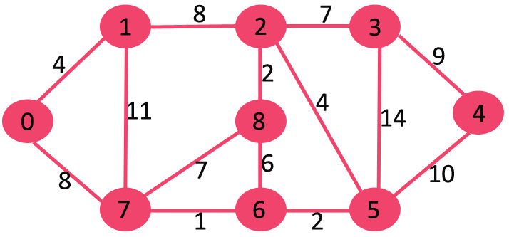
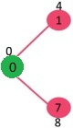
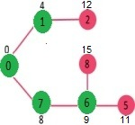
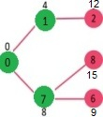
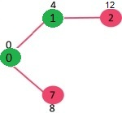
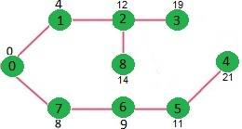
Shortest Path
Step 1:
The set sptSet is initially empty and distances assigned to vertices are {0, INF, INF, INF, INF, INF, INF, INF} where INF indicates infinite.
sptSet becomes {0}. After including 0 to sptSet, update distance values of its adjacent vertices
Vertex Distance from Source
0 0
1 4
2 12
3 19
4 21
5 11
6 9
7 8
8 14
Output: 0 4 12 19 21 11 9 8 14

Slide 38
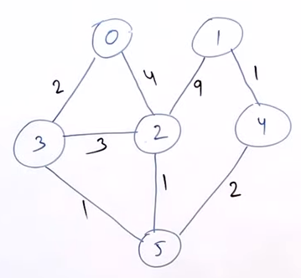
Example
(0,0)
(3,2)
(5,3)
(2,4)
(1,6)
0 | 0
1 | INF
2 | 4
3 | 2
4 | INF
5 | 3
Priority Queue
0 | 0
1 | INF
2 | INF
3 | INF
4 | INF
5 | INF
0 | 6 | 4 | 2 | 5 | 3
0 | 1 | 2 | 3 | 4 | 5
0 | 0
1 | INF
2 | 4
3 | 2
4 | INF
5 | INF
0 | 0
1 | INF
2 | 4
3 | 2
4 | 5
5 | 3
0 | 0
1 | 13
2 | 4
3 | 2
4 | 5
5 | 3
0 | 0
1 | 6
2 | 4
3 | 2
4 | 5
5 | 3

Slide 39
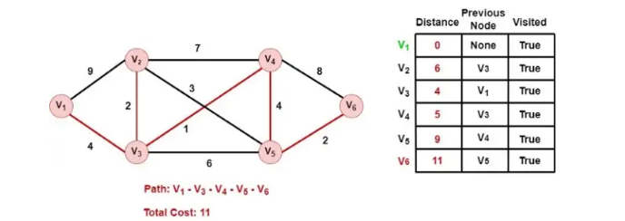
Example

Slide 40
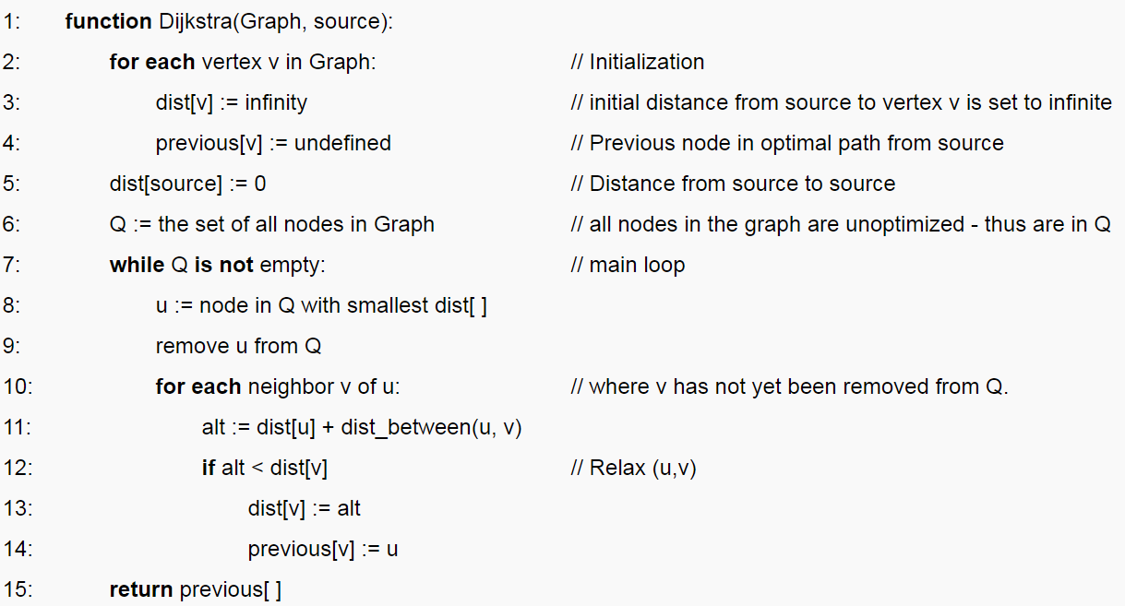
Algorithm

Slide 41
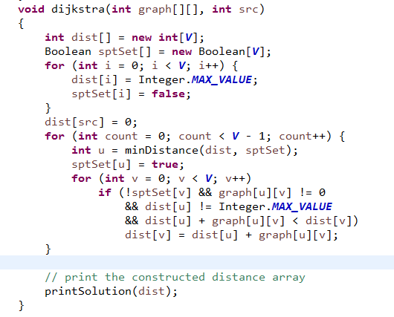
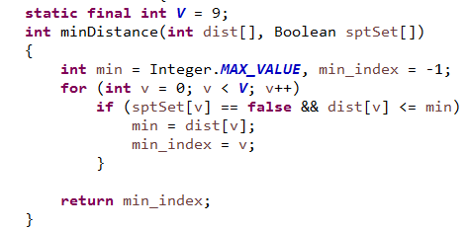
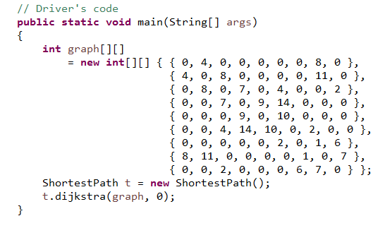
Implementation

Slide 42
Spanning Tree
Removing one edge from the SPT will become disconnected(Not Allo)
if you add single edge that then they will create loop.
if each edge have distinct graph that only one MSPT will possible
Complete Undirected Graph have (n^n-2 ) possible SPT.
Disconnected graph can not have any SPT
Mathematically
V’= V
E’ = V-1

Slide 43



From a complete graph, by removing maximum e - n + 1 edges, we can construct a spanning tree.
6-4+1 = 2 only one edge is allowed
N^n-2 = 4^4-2 = 16
3-3+! = 1 only one edge is allowed

Slide 44

Minimum Spanning Tree
A minimum spanning tree of a connected undirected weighted graph.
It has a subset of the edges from the original graph that connects all the vertices together, without any cycles and with the minimum possible total edge weight.

Slide 45
Algorithm for Finding MPST
Kruskal’s Algorithm
Prim’s Algorithm

Slide 46

Prim’s Algorithm
Remove Loop
Remove Parallel edges(keep edge whose weightage is minimum )
choose any arbitrary node as root node
Choose (outgoing or incident edges)
Select one edge who have min weightage

Slide 47





Step 1 - Remove all loops and parallel edges

Slide 48

Example

Slide 49

Kruskal's Spanning Tree Algorithm

Slide 50

Topological Sorting
Topological Sorting is possible if and only if the graph is a Directed Acyclic Graph.
There may exist multiple different topological orderings for a given directed acyclic graph.
1 2 3 4 5 6
1 2 3 4 6 5
1 3 2 4 5 6
1 3 2 4 6 5

Slide 51
Implementation

Slide 52
Thank you

